Slide 1
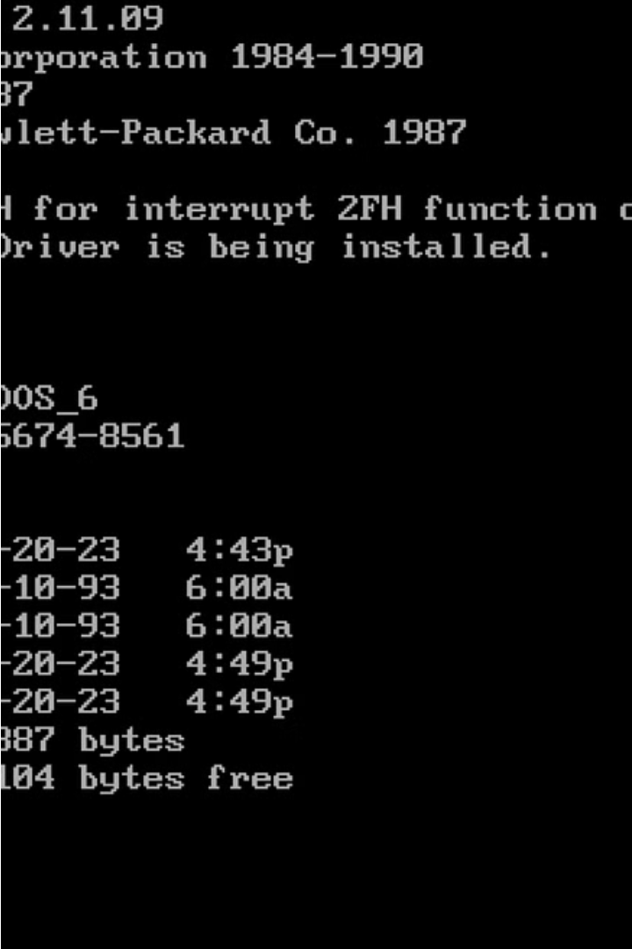

Introduction to Windows and DOS File Systems
Explore the fundamentals of Windows and DOS file systems, essential for forensic investigations. Understand the key concepts, structures, and common file formats that underpin these legacy operating systems.

Slide 2
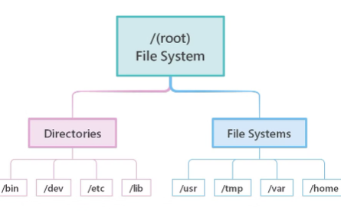
Overview of Windows File System Structures
Master File Table (MFT)
File System Hierarchy
File Metadata
The MFT is the central database that tracks all files and folders on a Windows file system, storing metadata like file names, sizes, and access permissions.
Windows file systems follow a hierarchical structure with a root directory (C:\) branching out into folders and subfolders to organize data in a tree-like fashion.
Each file and folder in a Windows file system contains metadata such as creation/modification dates, access control lists, and other attributes that provide valuable forensic information.

Slide 3



Understanding Windows File System Metadata
File Attributes
Timestamps
File Metadata
Windows file system metadata includes file attributes like read-only, hidden, and system that provide information about the file's properties.
Timestamps such as created, modified, and accessed dates give insights into a file's history and usage within the Windows ecosystem.
Other file metadata like size, owner, and permissions further enrich the understanding of a file's context and security within the Windows environment.

Slide 4
Forensic Analysis of Windows File Systems
File Metadata
1
Investigate file timestamps, owners, and access permissions
Data Structures
2
Examine file system layout, cluster chains, and Master File Table
Recovery Techniques
3
Recover deleted files, uncover hidden data, and analyze swap space
Forensic analysis of Windows file systems focuses on extracting critical metadata, understanding the underlying data structures, and applying specialized recovery techniques. This allows investigators to piece together a comprehensive picture of user activity, system events, and potential evidence, even in the face of intentional concealment or deletion.

Slide 5
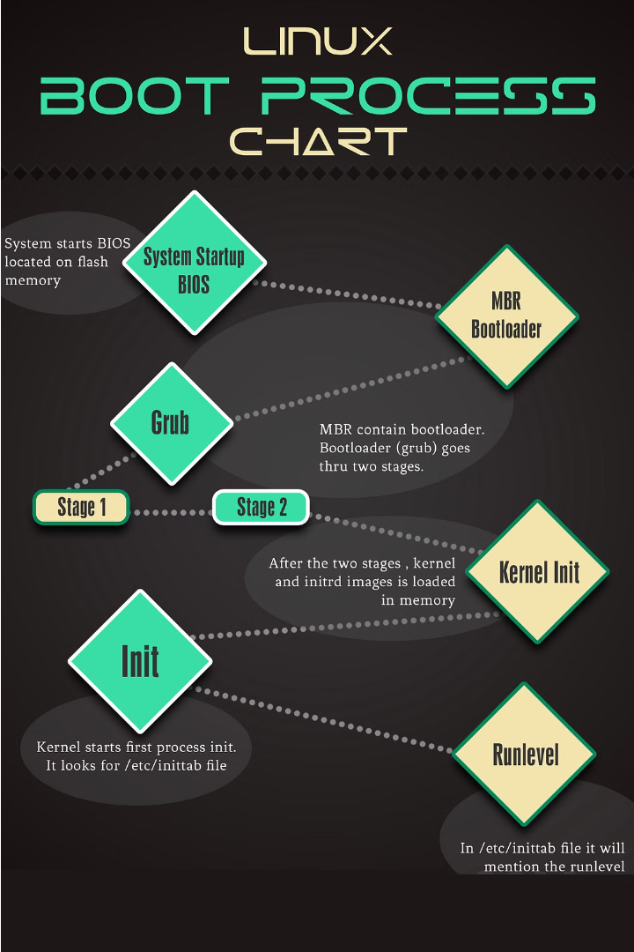
Introduction to Linux Boot Process
Understand the key stages of the Linux boot process, from the initial BIOS/UEFI handoff to the final system initialization. Gain insights into the Linux kernel loading, system services startup, and user session initialization.

Slide 6
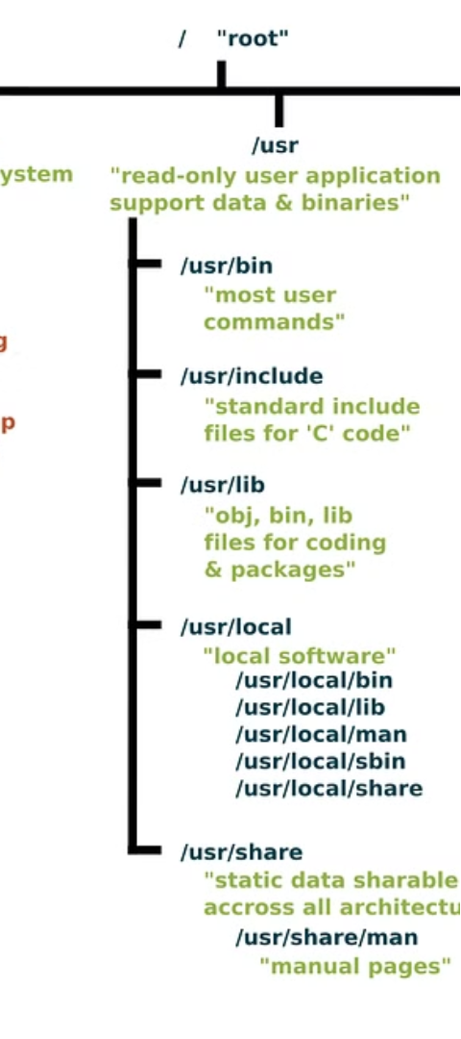
Linux File System Hierarchy and Structure
1
Root Directory (/)
2
Logical File System Structure
The root directory is the top-level directory in the Linux file system hierarchy, from which all other directories branch out.
Linux follows a standardized Filesystem Hierarchy Standard (FHS) that defines the purpose and organization of directories like /bin, /etc, /home, and /var.
3
Device Mounting
Storage devices like hard drives, USB drives, and network shares are "mounted" into the file system hierarchy, allowing users to access their contents.

Slide 7



Forensic Analysis of Linux File Systems
File System Structure
1
Understanding the Linux file system hierarchy and directory structure is crucial for forensic investigation.
Metadata Analysis
2
Examining file metadata like timestamps, permissions, and ownership can reveal important clues about file activities.
Log File Examination
3
Analyzing system and application logs can provide insights into user actions and potential security incidents.
Forensic analysis of Linux file systems involves a multi-faceted approach. Investigators must thoroughly understand the underlying file system structure, meticulously examine file metadata, and carefully review system and application logs to uncover valuable evidence. This comprehensive analysis enables them to piece together a detailed timeline of events and identify potential anomalies or suspicious activities.

Slide 8
Comparison of Windows, DOS, and Linux File Systems
Windows File System
DOS File System
Linux File System
Key Differences
The older DOS file system, like FAT32, has a simpler directory structure with 8.3 filename conventions. It lacks advanced features but can be more compatible with older hardware and software.
The main differences lie in file naming conventions, metadata, and advanced features like encryption and access control. Understanding these distinctions is crucial for forensic analysis across different operating systems.
The Windows file system, such as NTFS, uses a hierarchical structure with directories, files, and metadata like permissions and timestamps. It supports long file names and advanced features like encryption and compression.
Linux file systems, such as Ext4, use a similar hierarchical structure but with different metadata and features. They support advanced permissions, access control lists, and journaling for data integrity.

Slide 9
Challenges in Forensic Investigation of File Systems
Fragmentation and Deletion
Encryption and Access Controls
File systems can become fragmented over time, making it difficult to recover deleted or partially overwritten data. Forensic investigators must use advanced techniques to piece together these fragmented files.
Encrypted file systems and access controls can hinder forensic analysis by restricting access to critical data. Investigators must have the right tools and expertise to bypass these security measures.
Alternate Data Streams
File System Differences
Hidden or alternate data streams within file systems can store valuable evidence that may be overlooked by traditional forensic methods. Identifying and analyzing these streams requires specialized knowledge.
The varied structures and metadata of different file systems, such as NTFS, EXT4, and FAT, require investigators to have a deep understanding of each system's unique characteristics and recovery techniques.

Slide 10

Conclusion and Key Takeaways
In this presentation, we have explored the intricacies of Windows, DOS, and Linux file systems, as well as the forensic analysis techniques used to investigate these systems. The key takeaways highlight the need for a deep understanding of file system structures and metadata to effectively conduct digital forensic investigations.

